Slide 1
Machine Learning:- Color Detection Using Pandas & OpenCV
Khushi Agarwal
Priyadarshni Agrawal
Anushka

Slide 2
Contents:
What is colour Detection?
About the Python Project
Prerequisites
Steps for building a project
Screenshots of Source code
Output
Summary

Slide 3
What is Colour Detection?
.
Colour detection is the process of detecting the name of any color. Simple isn’t it? Well, for humans this is an extremely easy task but for computers, it is not straightforward. Human eyes and brains work together to translate light into color. Light receptors that are present in our eyes transmit the signal to the brain. Our brain then recognizes the color. Since childhood, we have mapped certain lights with their color names. We will be using the somewhat same strategy to detect color names.

Slide 4
About the Python Project
In this color detection Python project, we are going to build an application through which you can automatically get the name of the color by clicking on them. So for this, we will have a data file that contains the color name and its values. Then we will calculate the distance from each color and find the shortest one.

Slide 5
prerequisites
Dataset:- CSV File
Colors are made up of 3 primary colors; red, green, and blue. In computers, we define each color value within a range of 0 to 255. So in how many ways we can define a color? The answer is 256*256*256 = 16,581,375. There are approximately 16.5 million different ways to represent a color. In our dataset, we need to map each color’s values with their corresponding names. We will be using a dataset that contains RGB values with their corresponding names.
Libraries:-
OpenCV, Pandas are the Python packages that are necessary for this project in Python. To install them, simply run this pip command in our terminal:
pip install opencv-python numpy pandas

Slide 6
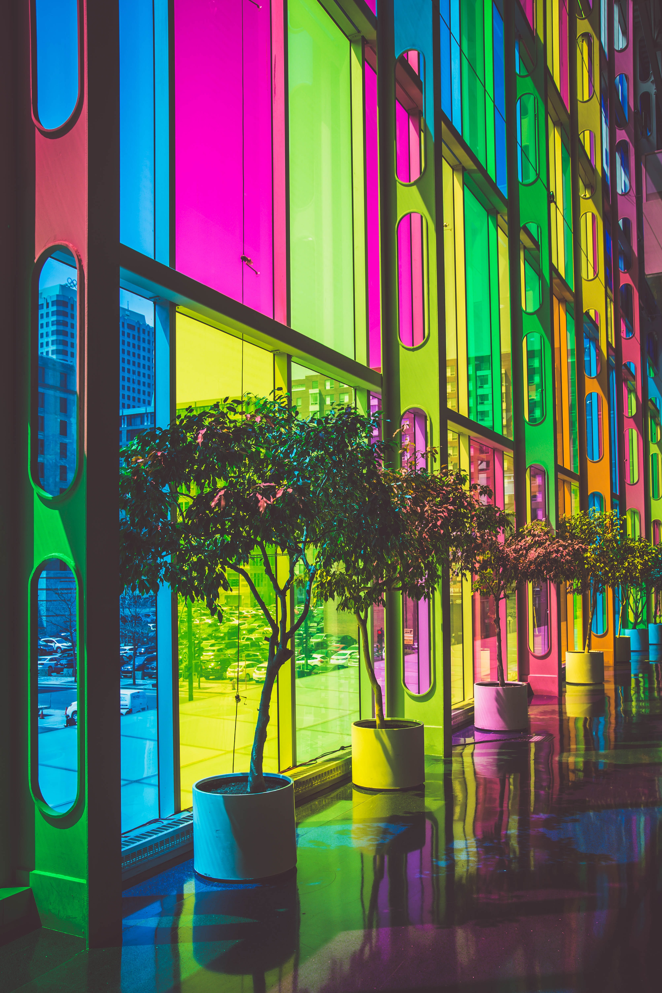
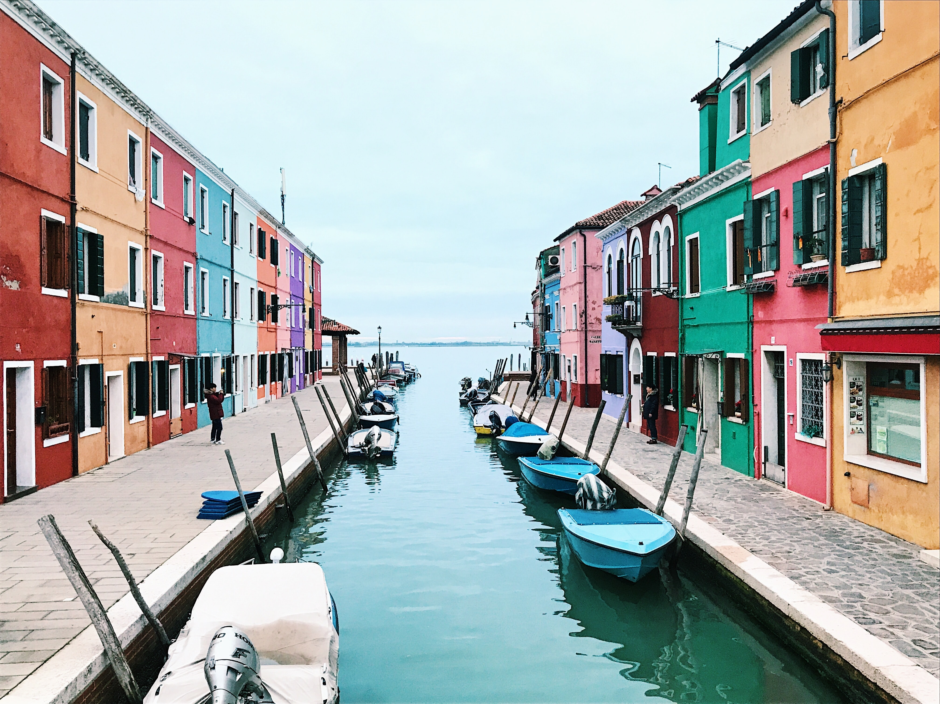
Images:- As input

Slide 7
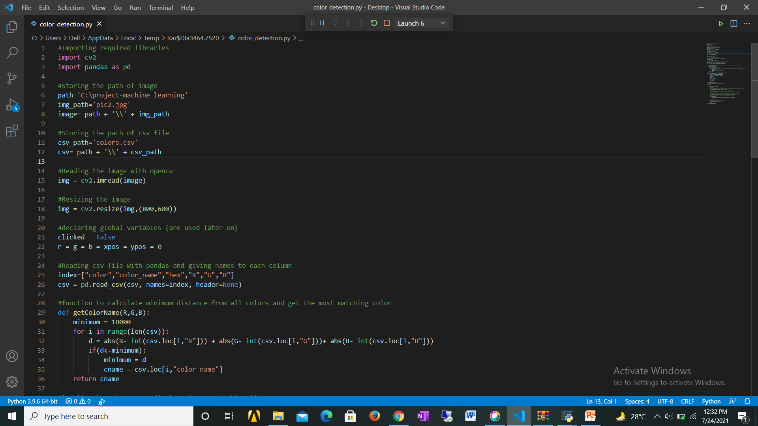

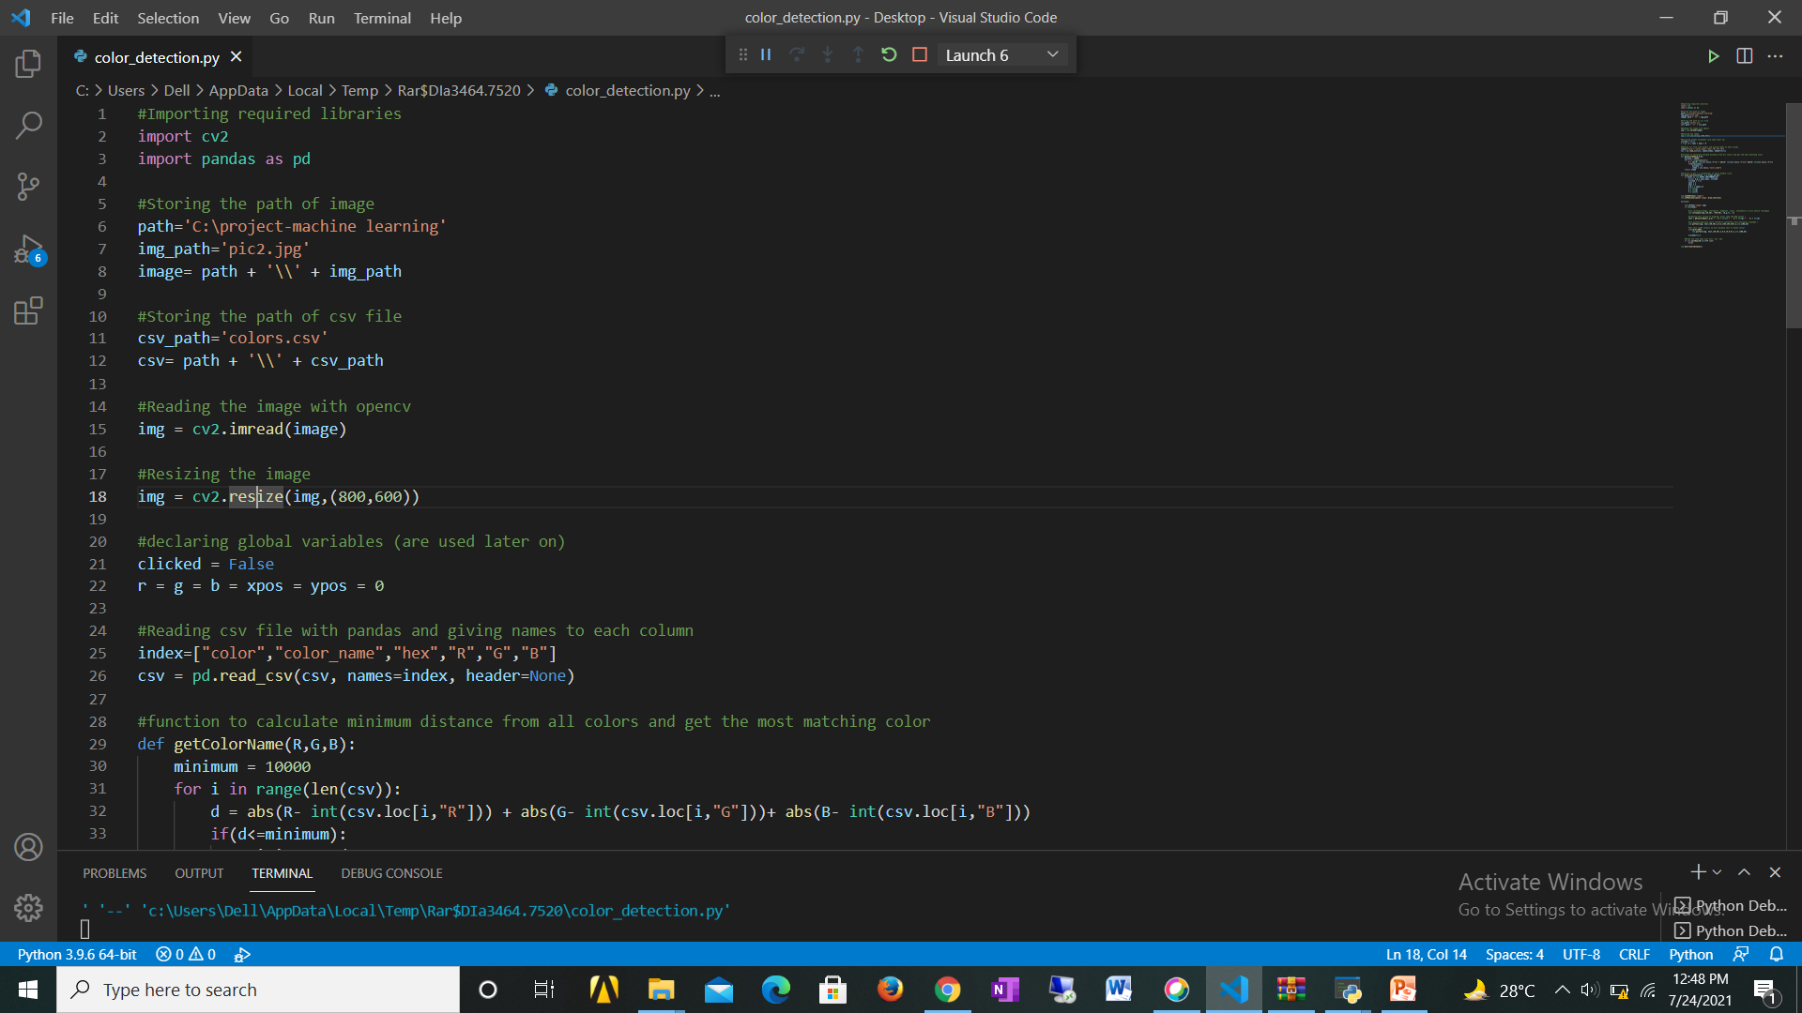
Steps of building a project
Import Required libraries
Taking an image from the user
Taking the CSV file from the user

Slide 8
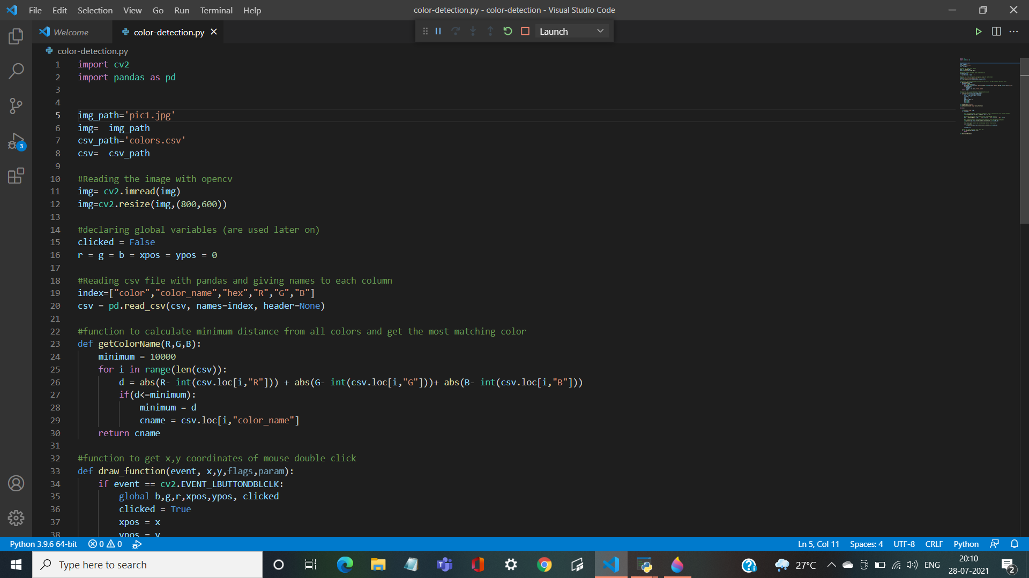
Source code

Slide 9
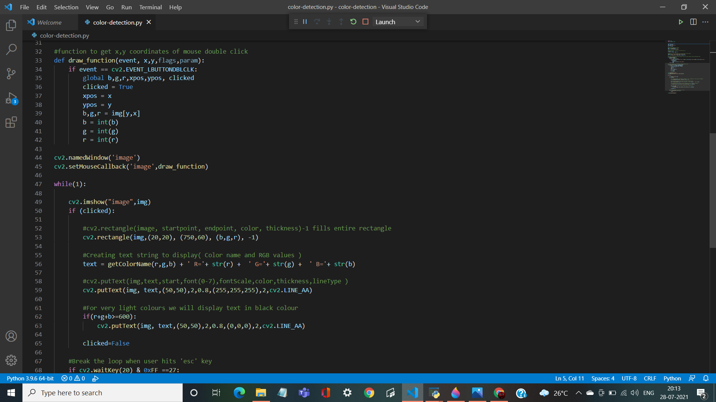

Slide 10
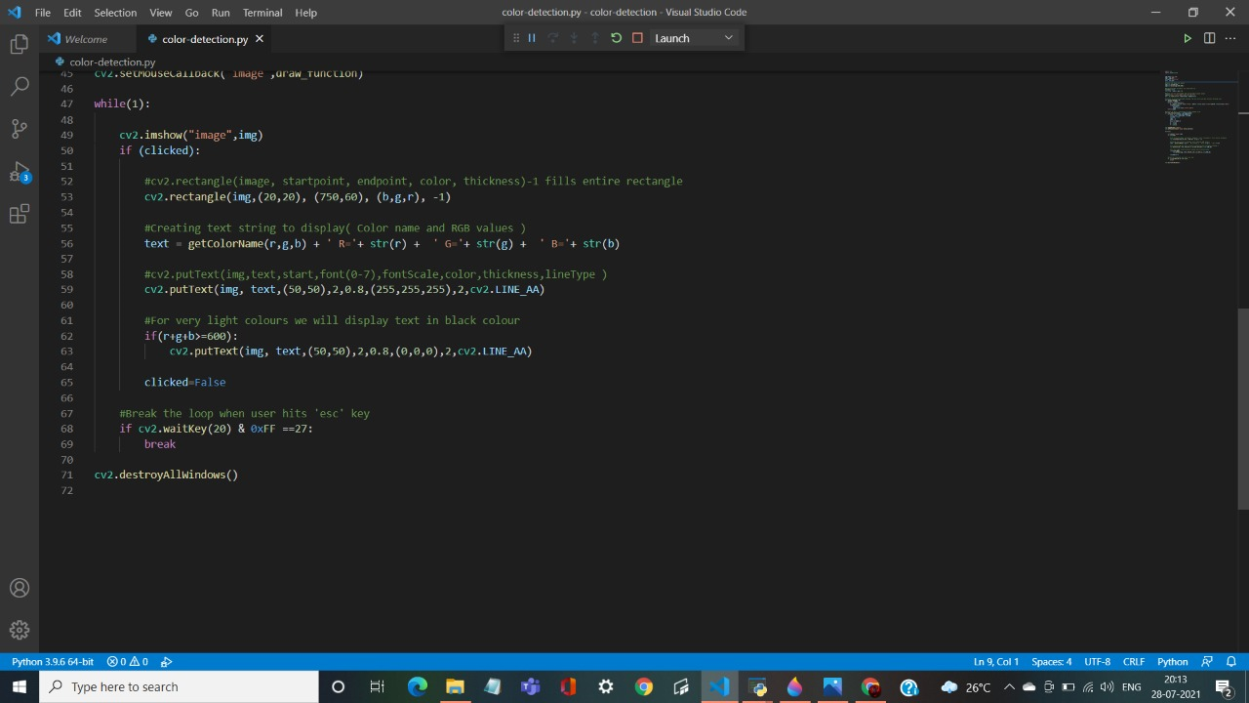

Slide 11
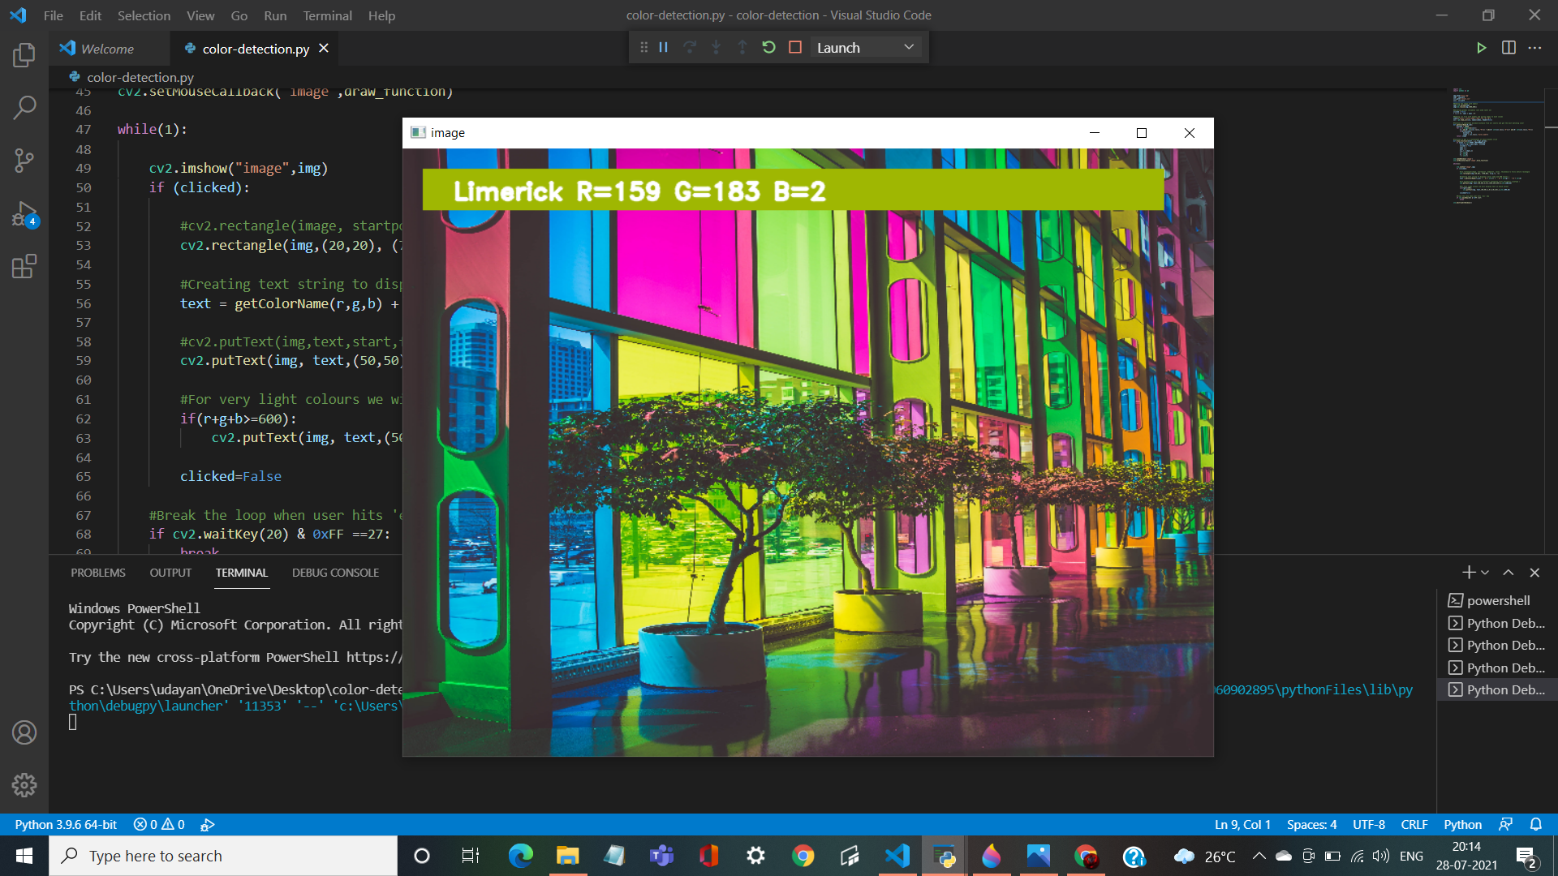
Output :-
1. For image 1 :-

Slide 12
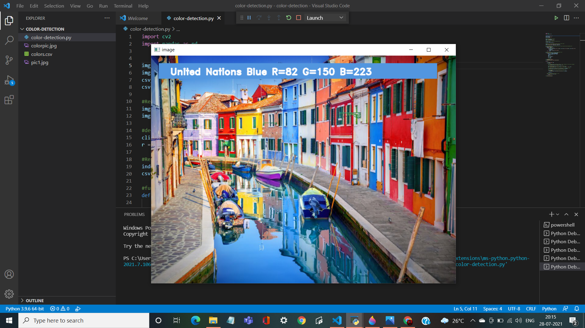
2. For image 2:-

Slide 13
SUMMARY :-
In this project we learned about colors and how we can extract color RGB values and the color name of a pixel. We learned how to handle events like double-clicking on the window and saw how to read CSV files with pandas and perform operations on data. This is used in numerous image editing and drawing apps.

Slide 14
THANKYOU

